Slide 1
Cape Fear Downtown Bakery
By Zachary Tyhacz & Nicholas Bartolotta

Slide 2
Business Name
Bakery / Restaurant
Local
Urban - Southern
“ The Cape Fear Downtown Bakery ”
Notes:
Started off with the name of the business. We knew it had to be a type of restaurant, a bakery specifically. We decided to make this business in a local area, Downtown, simply because all of the restaurants there have all of the culture in their names. For influence toward customers in the downtown area, we wanted it to be slightly urban, but southern.

Slide 3
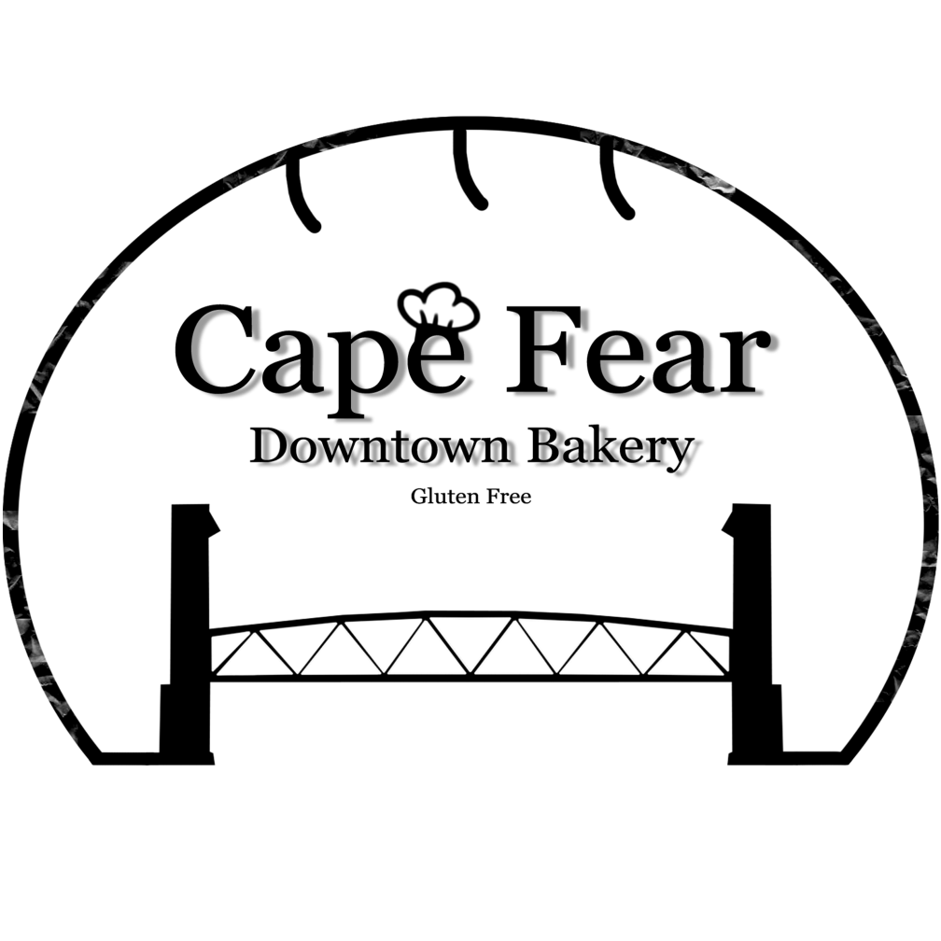
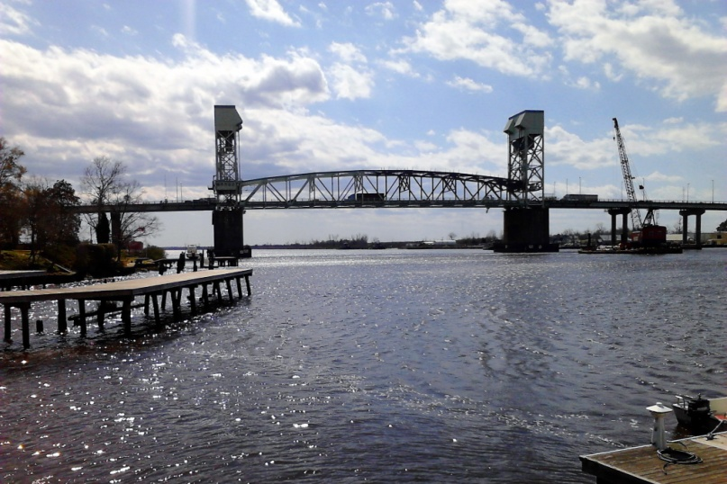
Logo
Clear, Simple Outline
Locality
Bakery Hints

Slide 4
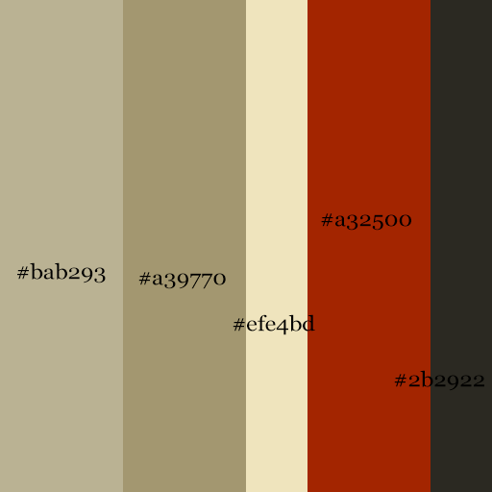
Preproduction
Audience
Local Families
Older People ( 50+ )
Color Scheme
Darker
George
George
Font
Serif
Taller, Bolder
Notes:
Preproduction of the website, audience mostly families and older people, color scheme to be dark to simulate hunger, warmth, closeness. Font was to be georgia, its taller, soft around edges, and thinner and bolder, slightly.

